Slide 1

adapted from New Zealand Numeracy Project
IKAN & GloSS Assessments
(Mathematics Reasoning Inventory)
Credentialing Training
Dr. Lya Snell, Mathematics Coordinator
Henry County Schools
Learning & Leadership Services

Slide 2
Read/Discuss
Fact Fluency Article
Learning & Leadership Services

Slide 3
Overview of Credentialing
(Practitioner Level)
Module 1: How Do I Give These Assessments?
      Administering the GloSS & IKAN Assessments with Fidelity
Module 2: What Does the Data From These
Assessments Tell Me?
      Understanding the Data
Module 3: How Do I Use the Data Instructionally?
      NZ Maths Numeracy Project
✓
Learning & Leadership Services

Slide 4
Ultimate Goals of
Credentialing Process
Every teacher will be trained to administer the IKAN and GloSS Assessments with fidelity
Every teacher will be able to understand the data and use the information to assist students with their numerical reasoning
Every student will be better math students as they progress in secondary schools because of the solid foundation in number sense gained from using the Numeracy Project
Learning & Leadership Services

Slide 5
TKES
This professional learning opportunity aligns to the following TKES standards:
Standard 1: Professional Knowledge
Standard 2: Instructional Planning
Standard 3: Instructional Strategies
Standard 4: Differentiated Instruction
Standard 5: Assessment Strategies
Standard 6: Assessment Uses
Standard 8: Academically Challenging Environment
Standard 9: Professionalism
Learning & Leadership Services

Slide 6
Module 1:
Administering the Assessments with Fidelity
(GloSS & IKAN)
REVIEW
Learning & Leadership Services
Notes:
Provide copies of the new GloSS Misconceptions FAQ sheet. Revisions were made, so this is the updated copy for teachers to have.

Slide 7
review of Module 1
DIRECTIONS: Work with your table partners and classmates to think about the following. Jot down your thoughts on the paper provided.
What is the purpose of these assessments?
Describe the GloSS.
Describe the IKAN Counting Interview.
Describe the IKAN Written Assessment.
Which assessment is administered first?
Describe the Strategy Stages 0 – 8 with a table partner.
Learning & Leadership Services
Notes:
Assign groups one question/statement to share out with the whole group. When you have given a few minutes for each group to discuss these six questions, have each group share out their answers to one of the discussion questions/statements.

Slide 8
Any Questions regarding the Beginning of the Year Administration???
Notes:
Address any frequently asked questions. Address the issue related to the Counting Interview and soft Stage 4. Teachers should not skip to the Written Assessment when they know for sure students have not fully mastered the Counting Interview (i.e. if the counting interview was previously administered and the student did not master it).

Slide 9
Module 2:
Understanding the Data
Learning & Leadership Services

Slide 10
Purpose
MATH REASONING & COMPREHENSION = MASTERY/TRUE UNDERSTANDING OF COMMON CORE MATH STANDARDS
IT IS IMPORTANT TO KNOW HOW THE STUDENT IS THINKING IN ORDER TO ADEQUATELY ASSIST HIM/HER WITH MISUNDERSTANDINGS. IT’S NOT JUST ABOUT THE RIGHT ANSWER, BUT MORE ABOUT MENTAL PROCESSING TO ARRIVE AT AN ANSWER.
Learning & Leadership Services

Slide 11
Overview of Module 2
Overview of Assessments & Expectations
Description of Strategy Stages
Summary Report
Data Interpretations (GloSS & IKAN)
Universal Screener Expectations
Understanding POINT
Flexible Grouping using the data
Performance Task with Actual Student Data
Using the Assessments for Tiers 1, 2, and 3 of MTSS
Overview of Module 3
Learning & Leadership Services

Slide 12
Description of Strategy Stages
It is important for teachers to understand the 0 - 8 strategy stages completely before administering this assessment.
Stage 0: EM (Emergent)
Stage 1: CA (One-to-one counting)
Stage 2: CA (Counting from one on materials)
Stage 3: CAI (Counting from one by imaging)
Stage 4: AC (Advanced counting)
Stage 5: EA (Early additive part-whole)
Stage 6: AA (Advanced additive/early multiplicative part-whole)
Stage 7: AM (Advanced multiplicative part-whole)
Stage 8: AP (Advanced proportional part-whole)
Learning & Leadership Services
Notes:
It is very important for teachers to understand the 9 strategy stages before administering the GloSS and IKAN assessments. Spend more time helping the teachers interpret Stages 5 – 8.

Slide 13
Are you really comfortable with the strategy stages?
How comfortable are you in identifying the different stages? Let’s see … ☺

Slide 14
How can you apply your understanding of strategy stages using anthony’s score sheet?
Learning & Leadership Services
Notes:
Spend time analyzing each section of the IKAN Counting Interview. Explain connection to Common Core. Answer any questions about this IKAN Counting Interview.

Slide 15
Understanding all sections of the ikan counting interview
Forward Number Word Sequence
Recognition and Sequence
Backward Number Word Sequence
R & S to 20, 120, 1000
Learning & Leadership Services
Notes:
Spend time analyzing each section of the IKAN Counting Interview. Explain connection to Common Core. Answer any questions about this IKAN Counting Interview.

Slide 16
Understanding all domains of ikan
Written Assessment
Number Sequence and Order
Fractions
Place Value
Basic Facts
Learning & Leadership Services
Notes:
Spend time analyzing each domain. Show sample questions from the IKAN Written Assessment for each domain.

Slide 17
Learning & Leadership Services
Notes:
Spend time explaining what this means and how to interpret the overall number knowledge stage and individual domain number stages.

Slide 18
Interpreting gloss and ikan data
Learning & Leadership Services

Slide 19
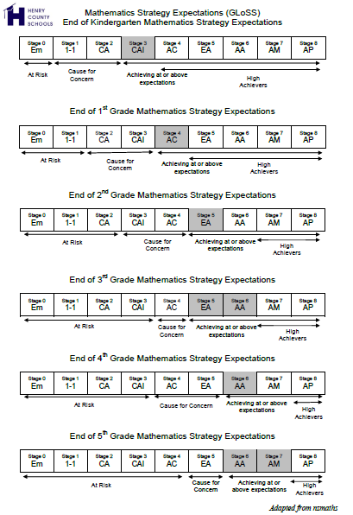
STRATEGY STAGE EXPECTATIONS
CONTINUUM
Learning & Leadership Services

Slide 20
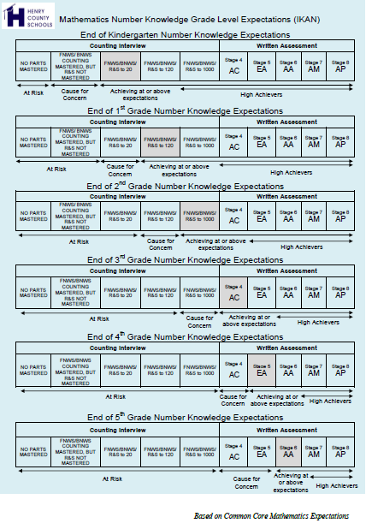
NUMBER KNOWLEDGE STAGE EXPECTATIONS
CONTINUUM
Learning & Leadership Services

Slide 21
What ‘s the difference?
Differentiated Instruction VS Flexible Grouping

Slide 22
Flexible grouping
Using GloSS & IKAN data
SCENARIO #1
Learning & Leadership Services
Notes:
Provide examples of how to flexibly group students using IKAN domain data OR GloSS domain data. Include a scenario here.

Slide 23


Understanding the data in…
Learning & Leadership Services

Slide 24
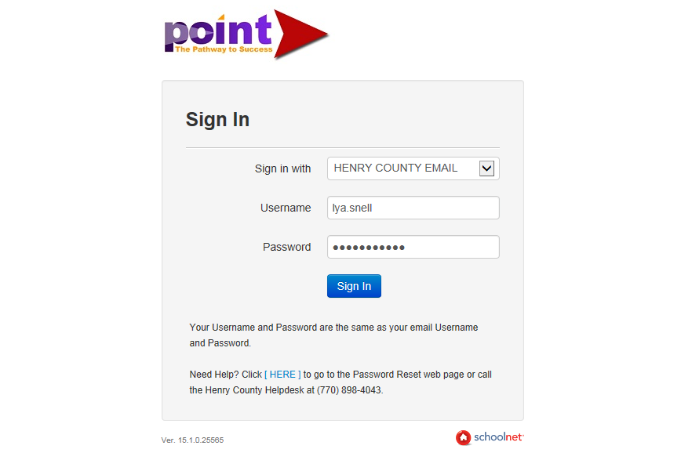
Log In
(using your network login)
Learning & Leadership Services

Slide 25
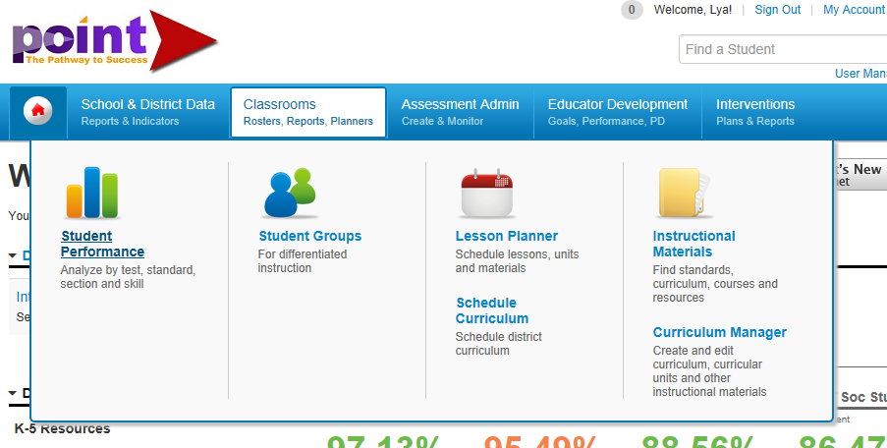
Go to classrooms
(click on Student Performance)
Learning & Leadership Services

Slide 26
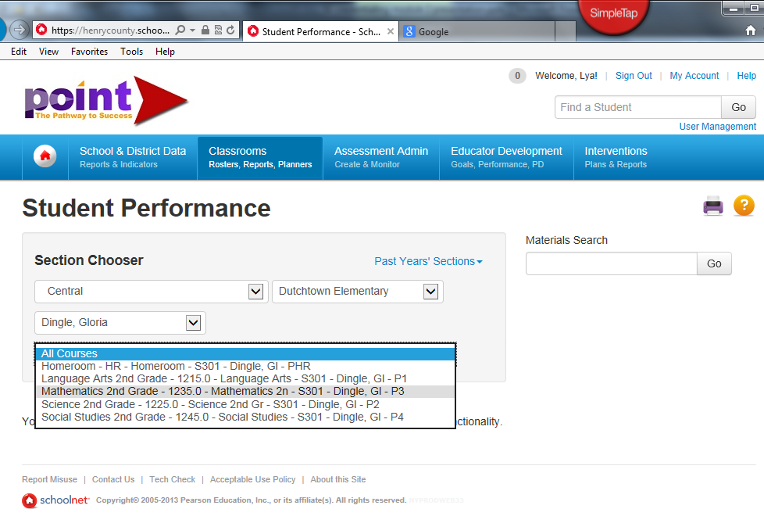
Click on mathematics section for your class
Learning & Leadership Services

Slide 27
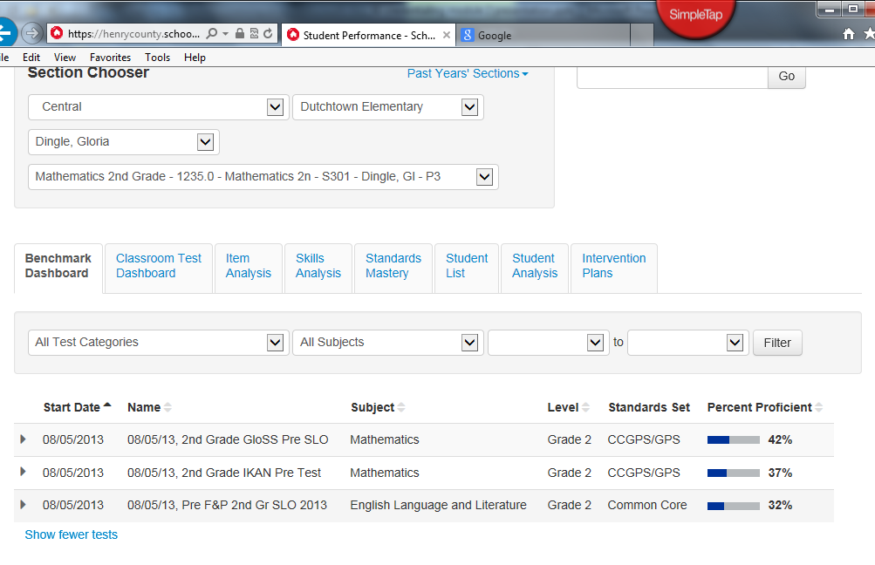
We will discuss the following…
Learning & Leadership Services
Notes:
Spend time reviewing the Item Analysis and Standards Mastery, grouping options, sorting capabilities, and linked resources for both the IKAN assessment and the GloSS assessment.

Slide 28
Differentiating instruction
Using GloSS & IKAN data
SCENARIO #2
Learning & Leadership Services
Notes:
Explain how to differentiate instruction using the NZ Maths Numeracy Project tasks (as a preview to Module 3).

Slide 29
District Suggestion…
During Mandatory Instructional Focus Time
When are we supposed to do this???
Learning & Leadership Services
Notes:
Explain how to differentiate instruction using the NZ Maths Numeracy Project tasks (as a preview to Module 3).

Slide 30
Mtss &
Nz maths numeracy project
(Using POINT Classrooms Tab)
Learning & Leadership Services
Notes:
Explain how to use POINT to create intervention plan using NZ Maths Numeracy Project. Show teachers how to access NZ Maths Numeracy Project materials using the Instructional Materials tab in POINT.

Slide 31
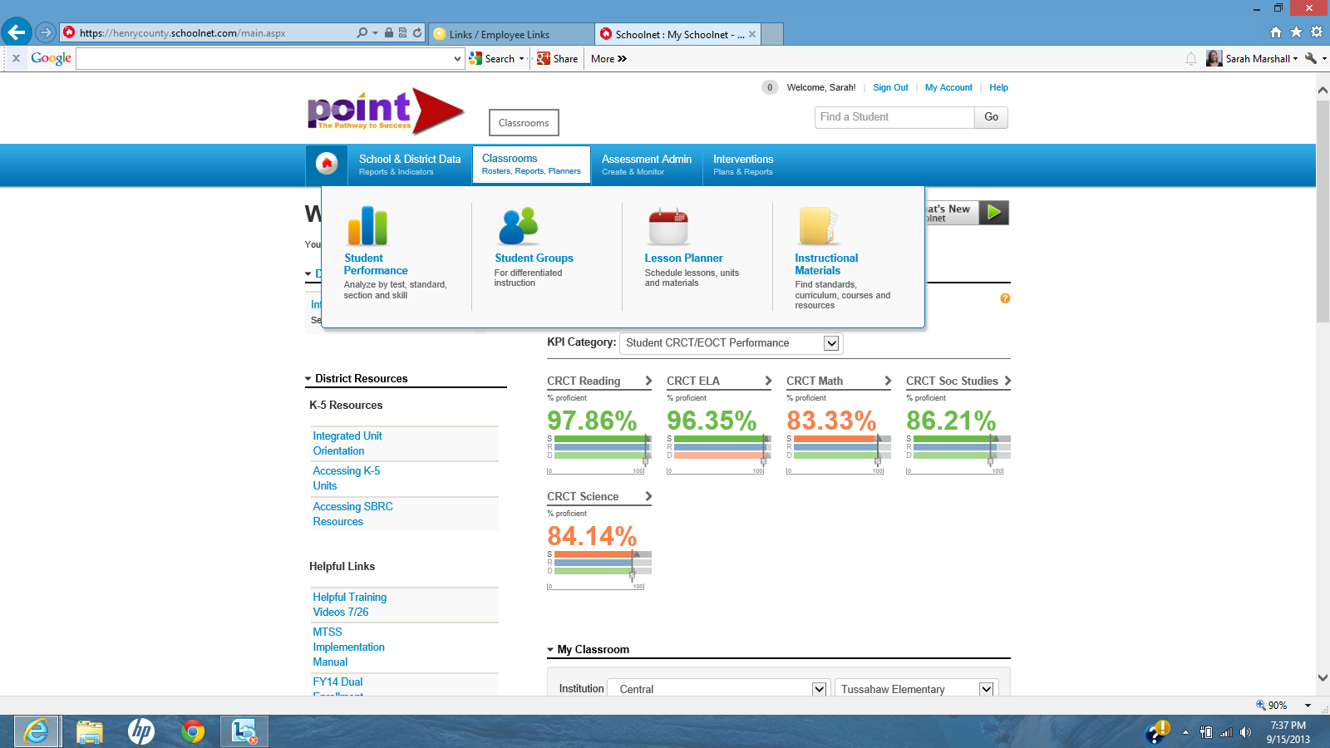
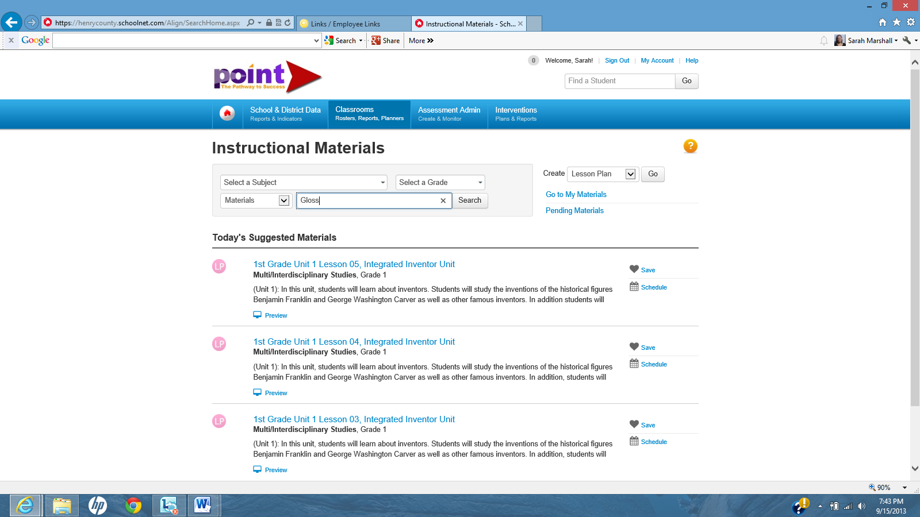
Go to the classrooms tab and click on Instructional Materials
Type Gloss as the keyword and Math as the subject. Be sure to unclick the box under it so that you are not limited to your grade level only.
Learning & Leadership Services
Notes:
Provide an Overview of Module 3 in preparation for the next PL session.

Slide 32
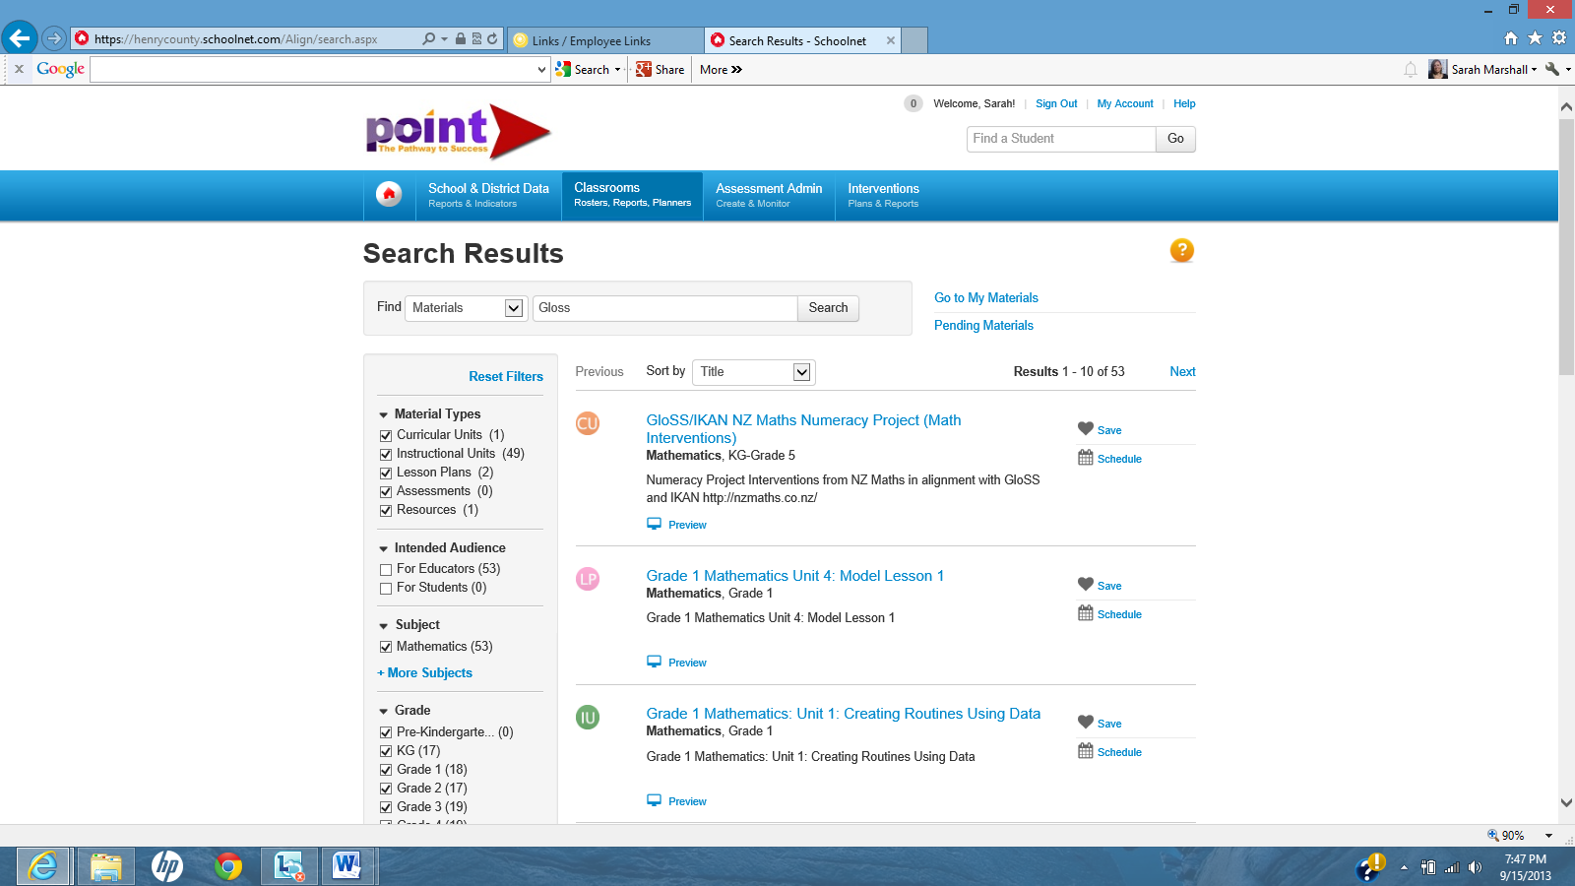
Learning & Leadership Services
Notes:
Provide an Overview of Module 3 in preparation for the next PL session.

Slide 33
Module 3:
Making Instructional Decisions Using GloSS/IKAN
Learning & Leadership Services
Notes:
Provide an Overview of Module 3 in preparation for the next PL session.

Slide 34
Q & A
Learning & Leadership Services

Slide 35
Overview of Module 3
Overview of Assessments & Expectations
Description of Assessments
Description of Strategy Stages
Overview of MTSS (Tiers 1 – 3)
Overview of NZ Maths Numeracy Project Interventions (Tasks & Stage Specific Probes)
Using Strategy Stage Assessments for Tier 1 Flexible Groups and Differentiation
Using NZ Maths Numeracy Project for Tier 2 & Tier 3 Interventions (structured to accommodate Tier 2 & 3 expectations)
Performance Task with Student Data
Learning & Leadership Services

Slide 36
Summary & Closing
Thank you for your time!!
Learning & Leadership Services

Slide 37
What have you learned?
Performance Assessments
Are you ready to teach others?
Learning & Leadership Services

